Slide 1
Summary of Work
For Mynt – CRM Analytics
Emiliano Tan

Slide 2
Project: Give Me The Next AAA Title
Goals:
Exploratory Analysis
What is the highest rated movie of 2020?
Who was the most popular actor in 2020?
What are the trends in user-movie preferences over the years?
Define a metric for a ‘hit movie’
How to make the next AAA title?
Dataset:
imdb (https://datasets.imdbws.com/)

Slide 3
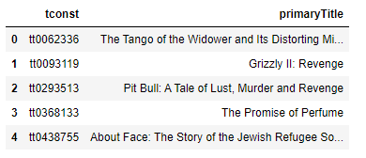
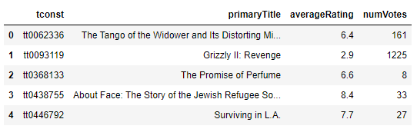
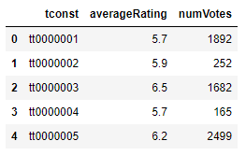
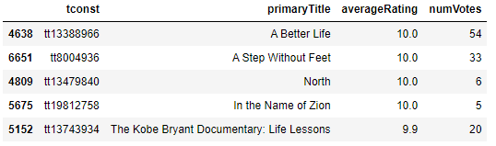
Highest Rated Movie in 2020
1
Load title_basics.tsv with ‘startYear’=2020 and ‘titleType’=‘movie’ to df_movies
3
Merge df_ratings to df_movies on tconst. Store to df_title_score
2
Load title_ratings.tsv to df_ratings
4
Sort df_title_score by averageRating and numVotes in descending order

Slide 4
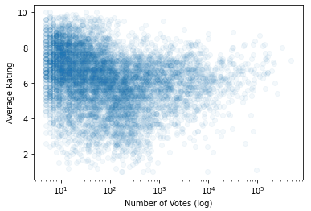
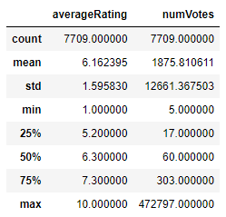
Highest Rated Movie in 2020
Based on sorting, A Better Life is the highest rated movie with a perfect rating of 10.0. However, notice that it only has a total of 54 votes.
Analyze the averageRating vs numVotes further through a scatterplot
Notice that the number of votes garnered by movies are spread out largely. To account for this, we can set a minimum requirement of number of votes to qualify a certain movie in the ratings.

Slide 5
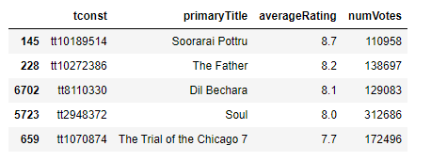
Highest Rated Movie in 2020
Let us say that the metric for a popular movie means acquiring a total number of votes of 100000. Do the same method, but filter numVotes >= 100000 before sorting.
Based on sorting with threshold, Soorarai Pottru is the highest rated movie with at least 100,000 votes at a rating of 8.7.
The threshold set was arbitrary. Furthermore, it can also be set as the mean, or the median of the number of votes in the dataset. This means that it introduces a certain level of bias in our exploration.

Slide 6
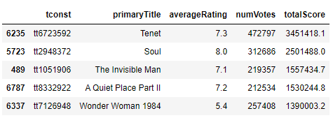
Highest Rated Movie in 2020
From the description in the imdb website: averageRating – weighted average of all the individual user ratings.
To properly gauge the rating of a movie, we can treat the number of votes as the weight of the significance of a movie’s rating. This means that when measuring the ‘hit factor’ of a movie, we can take the Accumulated Rating (averageRating x numVotes) to determine the totalScore of a movie.
Introduce a new column totalScore and sort the data frame again by that new column.
Based on accumulated rating, Tenet is the highest rated movie with at 472,797 votes at a rating of 7.3.

Slide 7
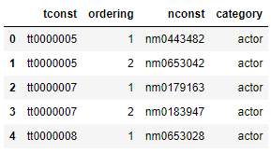
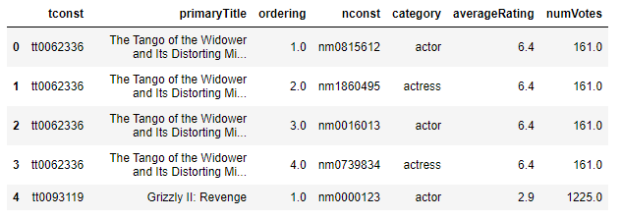
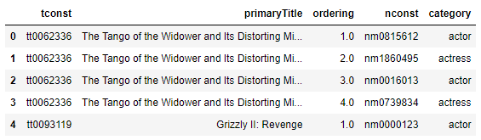
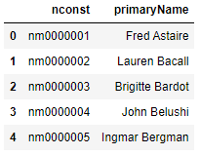
Most Popular Actor in 2020
1
Load title_principals.tsv with ‘startYear’=2020 and ‘titleType’=‘movie’ to df_principals
3
Merge df_ratings to df_principals_year on tconst. Store to df_principals_ratings
2
Merge df_principals to df_movies on tconst. Store to df_principals_year
4
Load name_basics.tsv to df_ratings

Slide 8
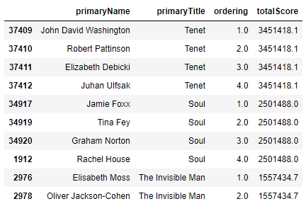
Most Popular Actor in 2020
5
Merge df_name to df_principals_ratings on nconst. Store to df_principals_ratings_names. Create an aggregated column with the totalScore (averageRating x numVotes). Sort the resulting data frame by descending totalScore and ascending ordering.
From the results, we can see that John David Washington, as the main character in the movie Tenet, garnered the highest total cumulative score for the year 2020. By this observation, we can say that he is the most popular actor of 2020.

Slide 9
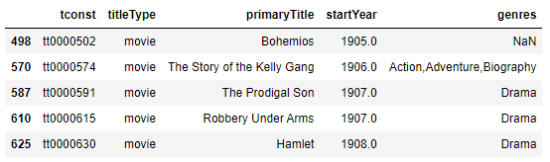
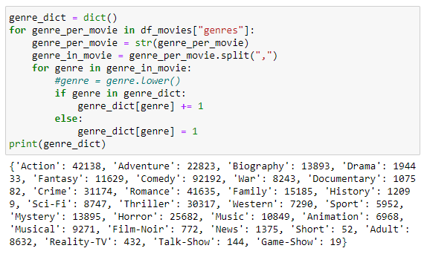
User-Movie Preference Trend
We can get an idea of the trend of the user-movie preference by plotting the average rating of movies versus the year per genre.
First, we must identify all the genres in the imdb dataset.
1
Load title_basics.tsv with ‘titleType’=‘movie’ to df_movies
3
Count all the strings parsed in genres and store the count in a dictionary.
2
Drop rows with null values

Slide 10
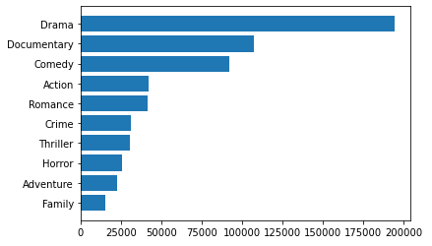
User-Movie Preference Trend
Since there is a lot of available genres, we can focus only on the top 10 genres in terms of frequency.
To move forward, helper functions were created to solve for the weighted average ratings of the movies for each year. The result is stored to df_yearly_rate.
This will be looped and stored into a dictionary with the genre name as the key.

Slide 11
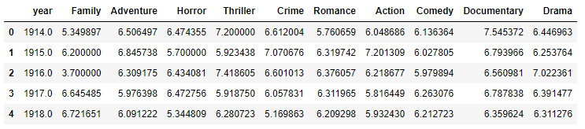
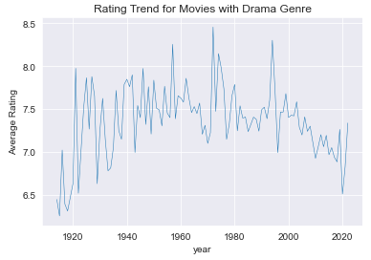
User-Movie Preference Trend
After looping through the genres, this will be the trend dataset:
An initial inspection on the trend of the rating for the Drama genre is shown on the right. Although we can see a trend, the data is still noisy.
To smoothen this out, we can define a moving average function to help us in our visualization.

Slide 12
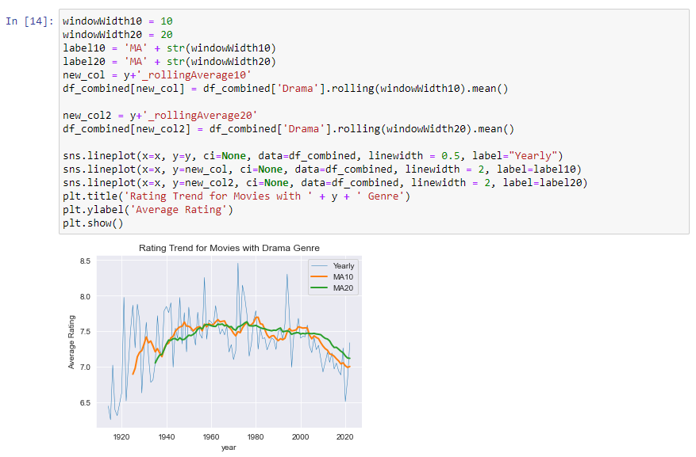
User-Movie Preference Trend
In the moving average, we have shown a 10-year and a 20-year window to show a short-term and long-term trend.
For the Drama genre, we can observe a noticeable decline in the average rating starting from year 2000.
We can continue to analyze the trend for the other genres.

Slide 13
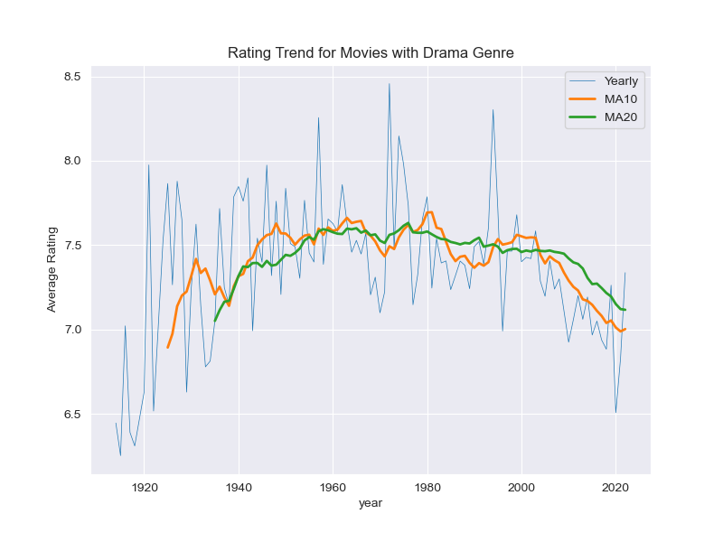
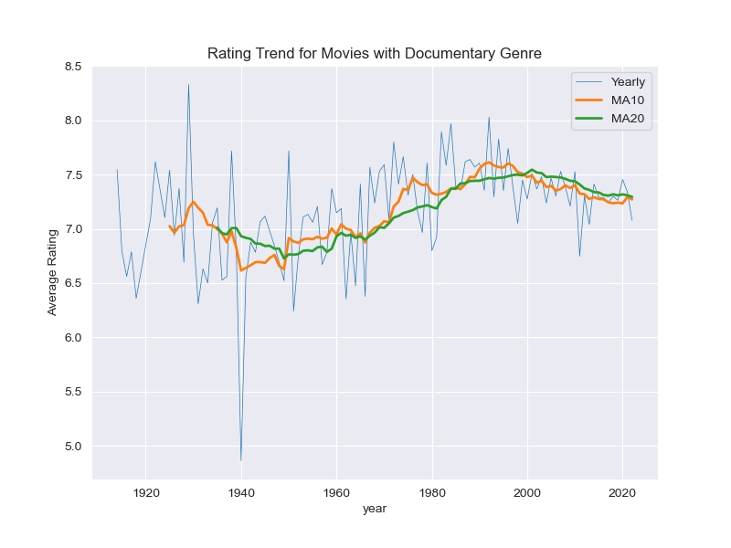
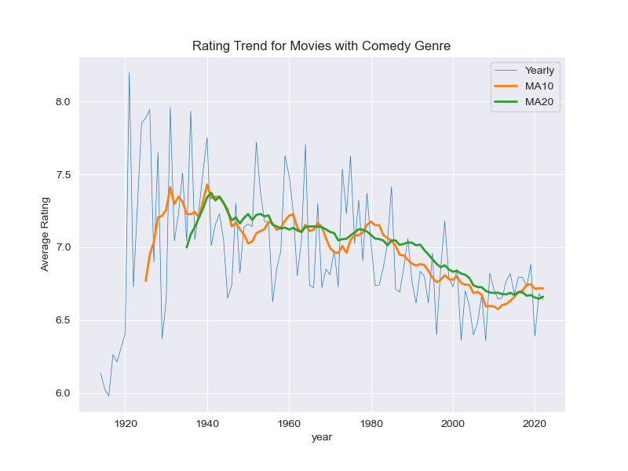
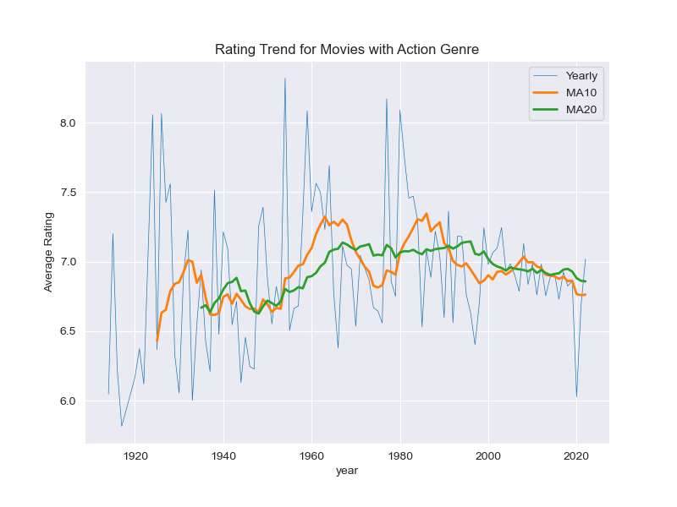
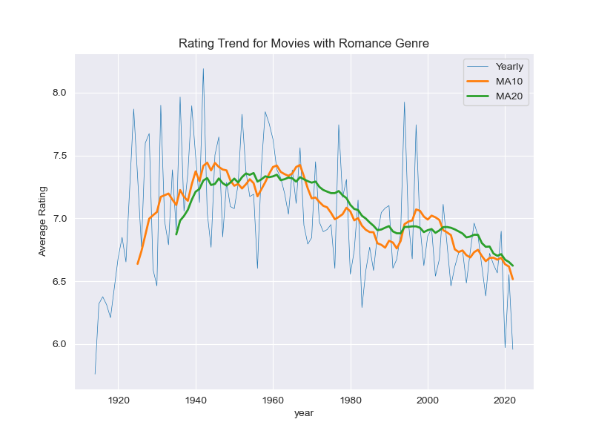
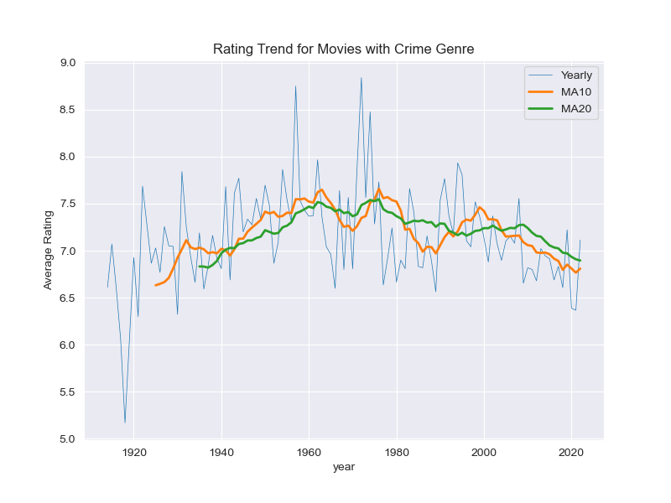
User-Movie Preference Trend
Drama
Documentary
Comedy
Action
Romance
Crime

Slide 14
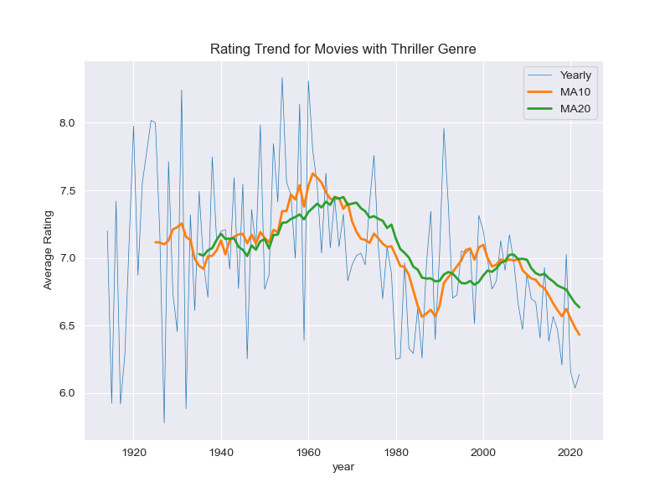
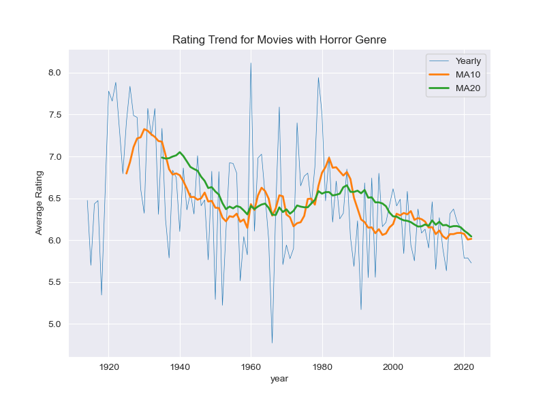
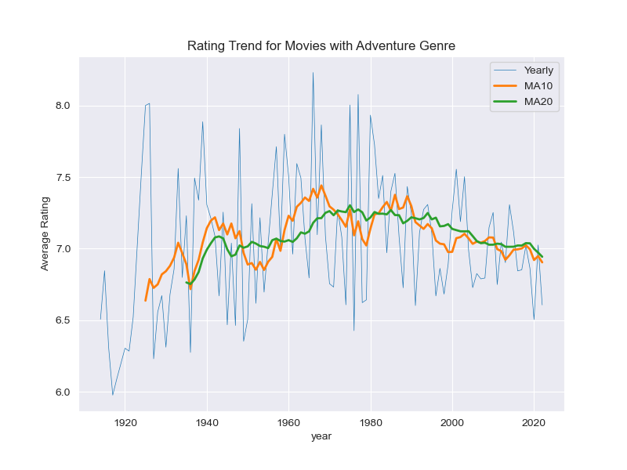
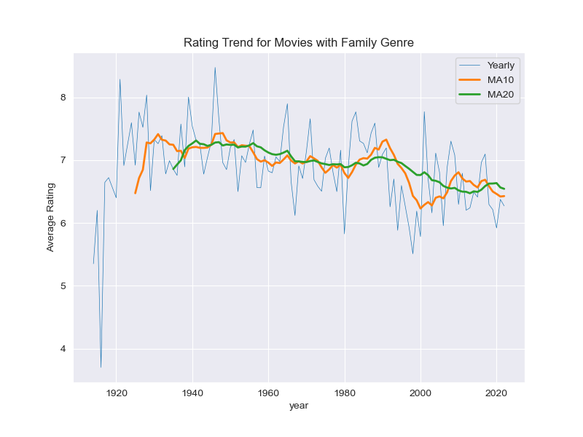
User-Movie Preference Trend
Thriller
Horror
Adventure
Family

Slide 15
User-Movie Preference Trend
From the plots, we can observe the following:
There is a noticeable decline in the ratings of Horror, Thriller, Romance and Comedy genres.
Adventure, Family and Crime genres are also seeing this slow decline in rating starting 1980s.
Action and Documentary genres are showing a relatively steady trend in ratings
Over-all there is no observable increase in the movie rating for all the top 10 genres within 1980 to 2022.
Possible reasons are:
Rise of TV series
Increase in standards of the viewers due to rising technology

Slide 16
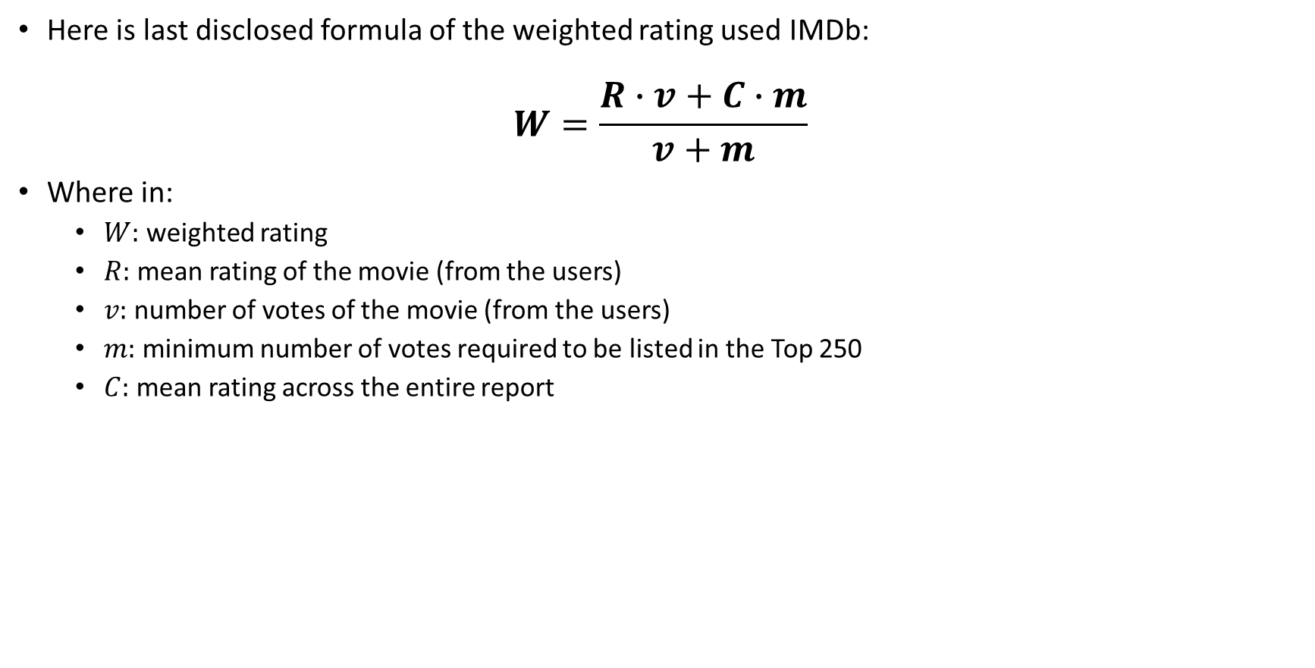
Define a Metric for a ‘Hit Movie’
Here is last disclosed formula of the weighted rating used IMDb:
$$W=\frac{R∙v+C∙m}{v+m}$$
Where in:
$W:$ weighted rating
$R:$ mean rating of the movie (from the users)
$v:$ number of votes of the movie (from the users)
$m:$ minimum number of votes required to be listed in the Top 250
$C:$ mean rating across the entire report

Slide 17
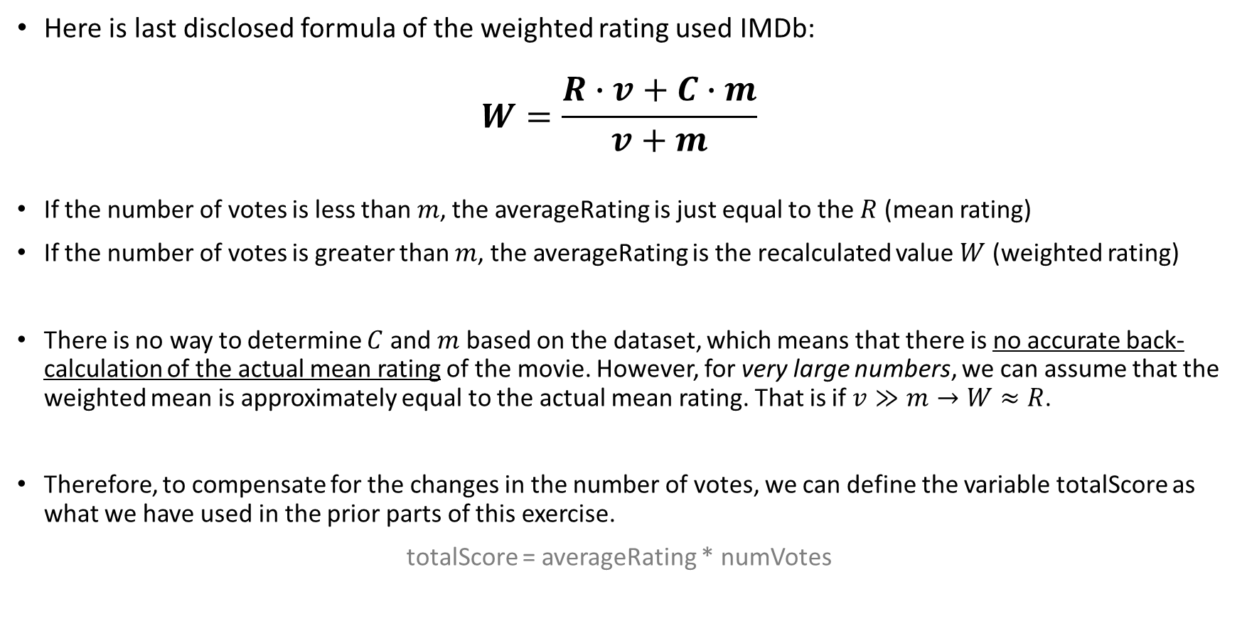
Define a Metric for a ‘Hit Movie’
Here is last disclosed formula of the weighted rating used IMDb:
$$W=\frac{R∙v+C∙m}{v+m}$$
If the number of votes is less than $m$, the averageRating is just equal to the $R$ (mean rating)
If the number of votes is greater than $m$, the averageRating is the recalculated value $W$ (weighted rating)
There is no way to determine $C$ and $m$ based on the dataset, which means that there is no accurate back-calculation of the actual mean rating of the movie. However, for very large numbers, we can assume that the weighted mean is approximately equal to the actual mean rating. That is if $v≫m→W≈R$.
Therefore, to compensate for the changes in the number of votes, we can define the variable totalScore as what we have used in the prior parts of this exercise.
totalScore = averageRating * numVotes

Slide 18
How to Make the Next AAA Title?
Goal: Determine the keywords in the title that are common in the ‘hit movies’
Strategy: Score each word in the title using the totalScore metric
Methodology:
Filter the dataset by genre
Limit the dataset to recent and top movies (2000-present, upper 2500 of the rankings)
Clean the titles (Remove stop words, remove numbers, remove ‘:’)
Recommendation – stemming and lemmatization
Create a bag-of-words (Tfidf) for the title to determine the relevance of each word
Concatenate the resulting data frame to the data frame with tconst and totalScore
Get the weighted score by multiplying the tfidf dataframe by the totalScore per movie
Take the sum of the score of each word
Divide the sum by the minimum value to normalize the results
Sort in descending order

Slide 19
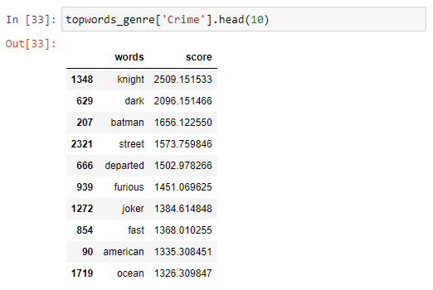
How to Make the Next AAA Title?
Here is a sample result for the ‘Crime’ genre:
The visualization of the data can further be aided through wordclouds

Slide 20
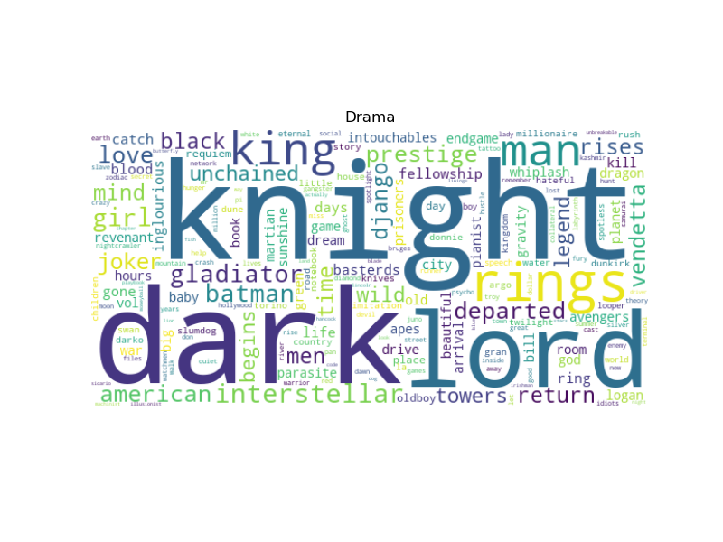
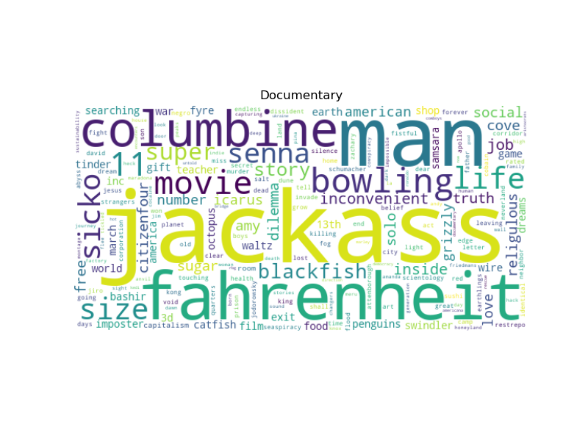
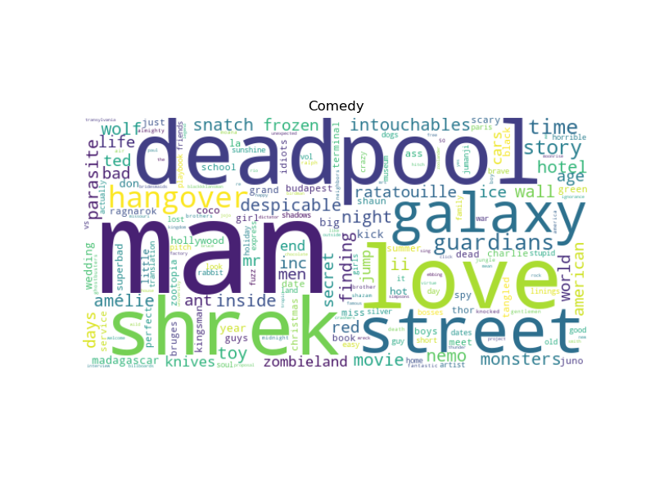
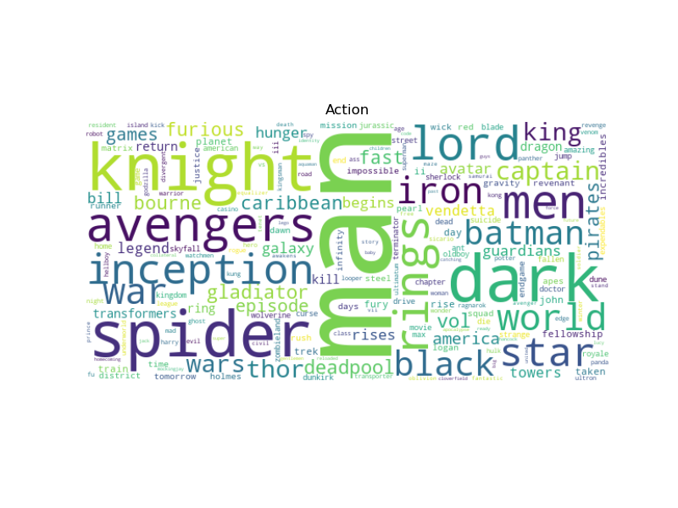
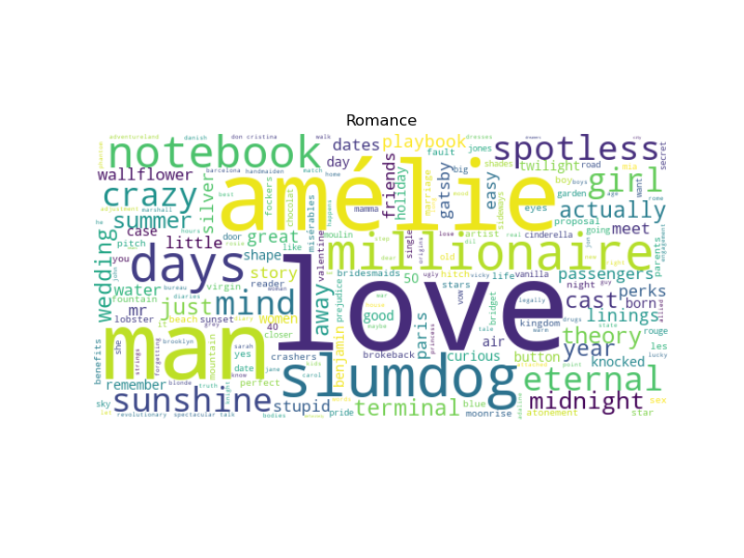
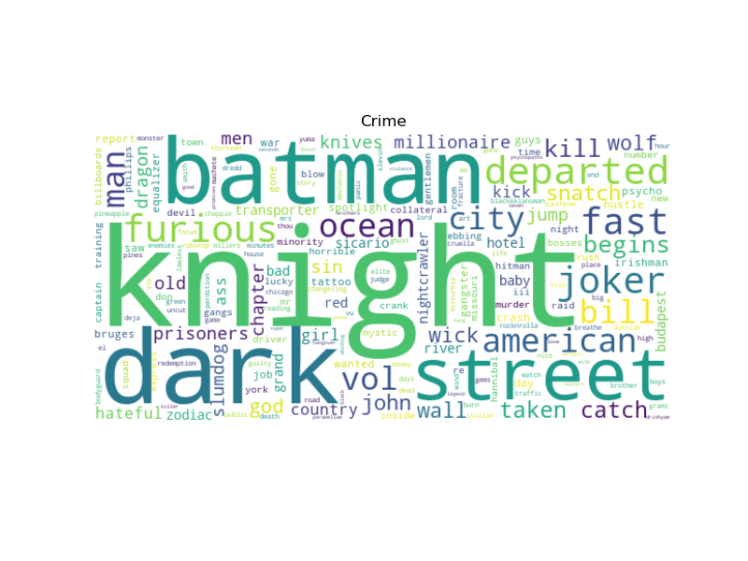
How to Make the Next AAA Title?
Drama
Documentary
Comedy
Action
Romance
Crime

Slide 21
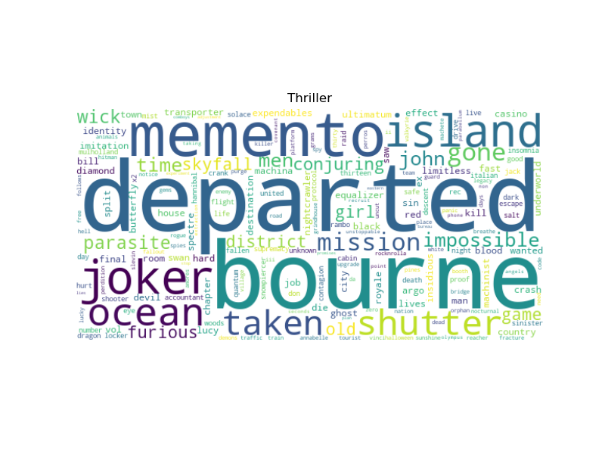
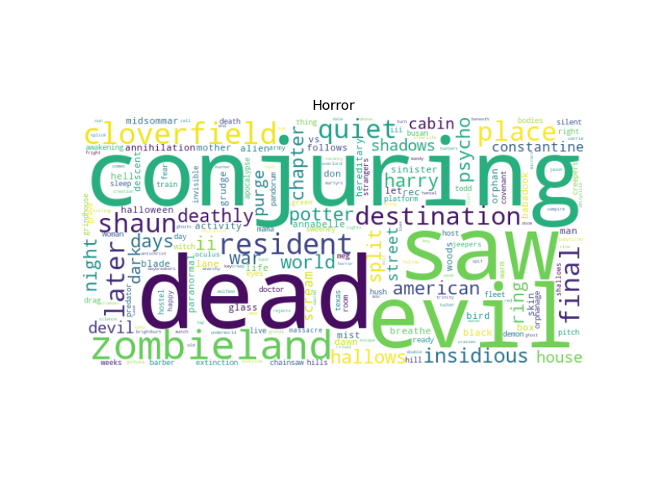
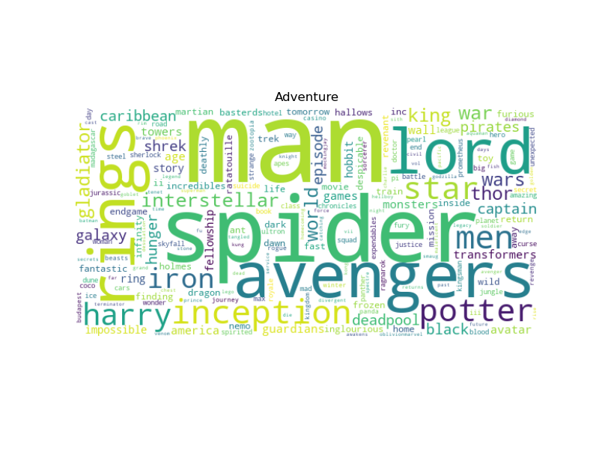
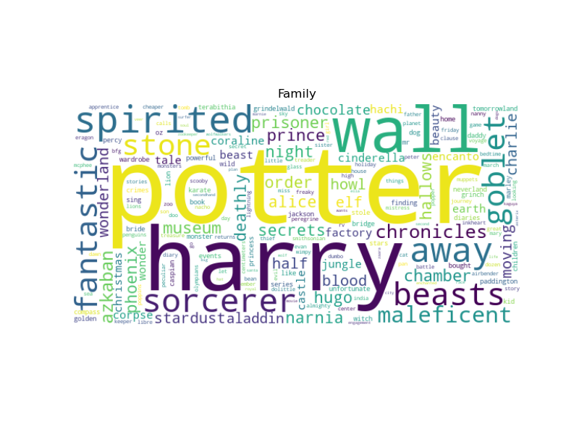
How to Make the Next AAA Title?
Thriller
Horror
Adventure
Family

Slide 22
How to Make the Next AAA Title?
Therefore, if we are intending to give our next project the best possible movie title so that it could be a hit based on historical data, we can start with the top words generated for each genre
Recommendation:
Include all the genres
Do not limit the dataset by year and the top ranks
Build a predictive NLP model – how to create more sensible movie titles based on the existing movie titles?

Slide 24
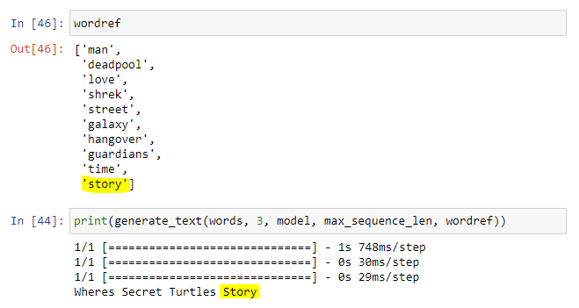
Predicting the Next Movie Title
Goal: Create a model to predict the next movie title
Strategy: The model should emulate a ‘Movie Title Generator’ which accounts for the genre of the desired movie
Ideas:
Use LSTM
Start with a random seed_text
Generate movie titles until a word is present in the top 10 words of the selected genre

